Slide 1



COVID-19 for Steinkjer
View in Power BI
Last data refresh:
23.04.2020 08:10:19 Romance Standard Time
Downloaded at:
23.04.2020 08:24:35 Romance Standard Time

Slide 2
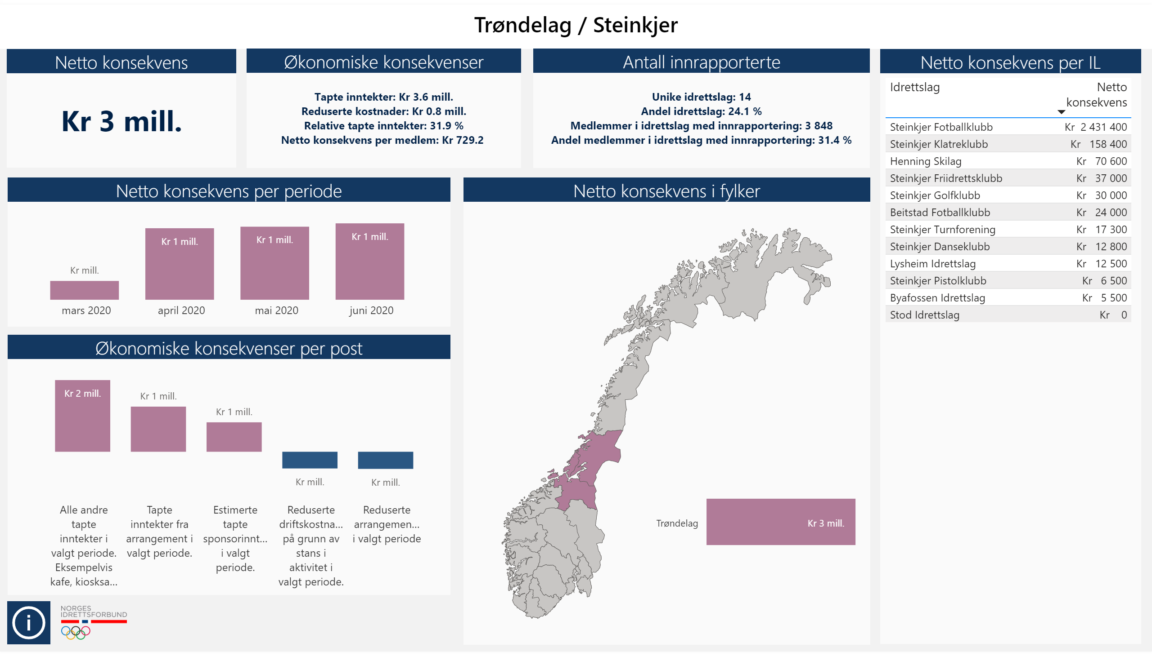

Slide 3
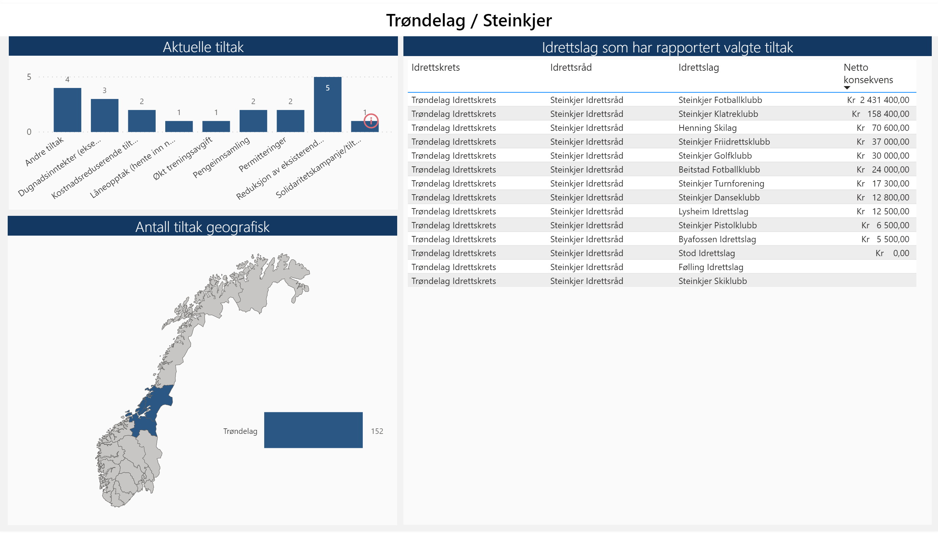

Slide 4
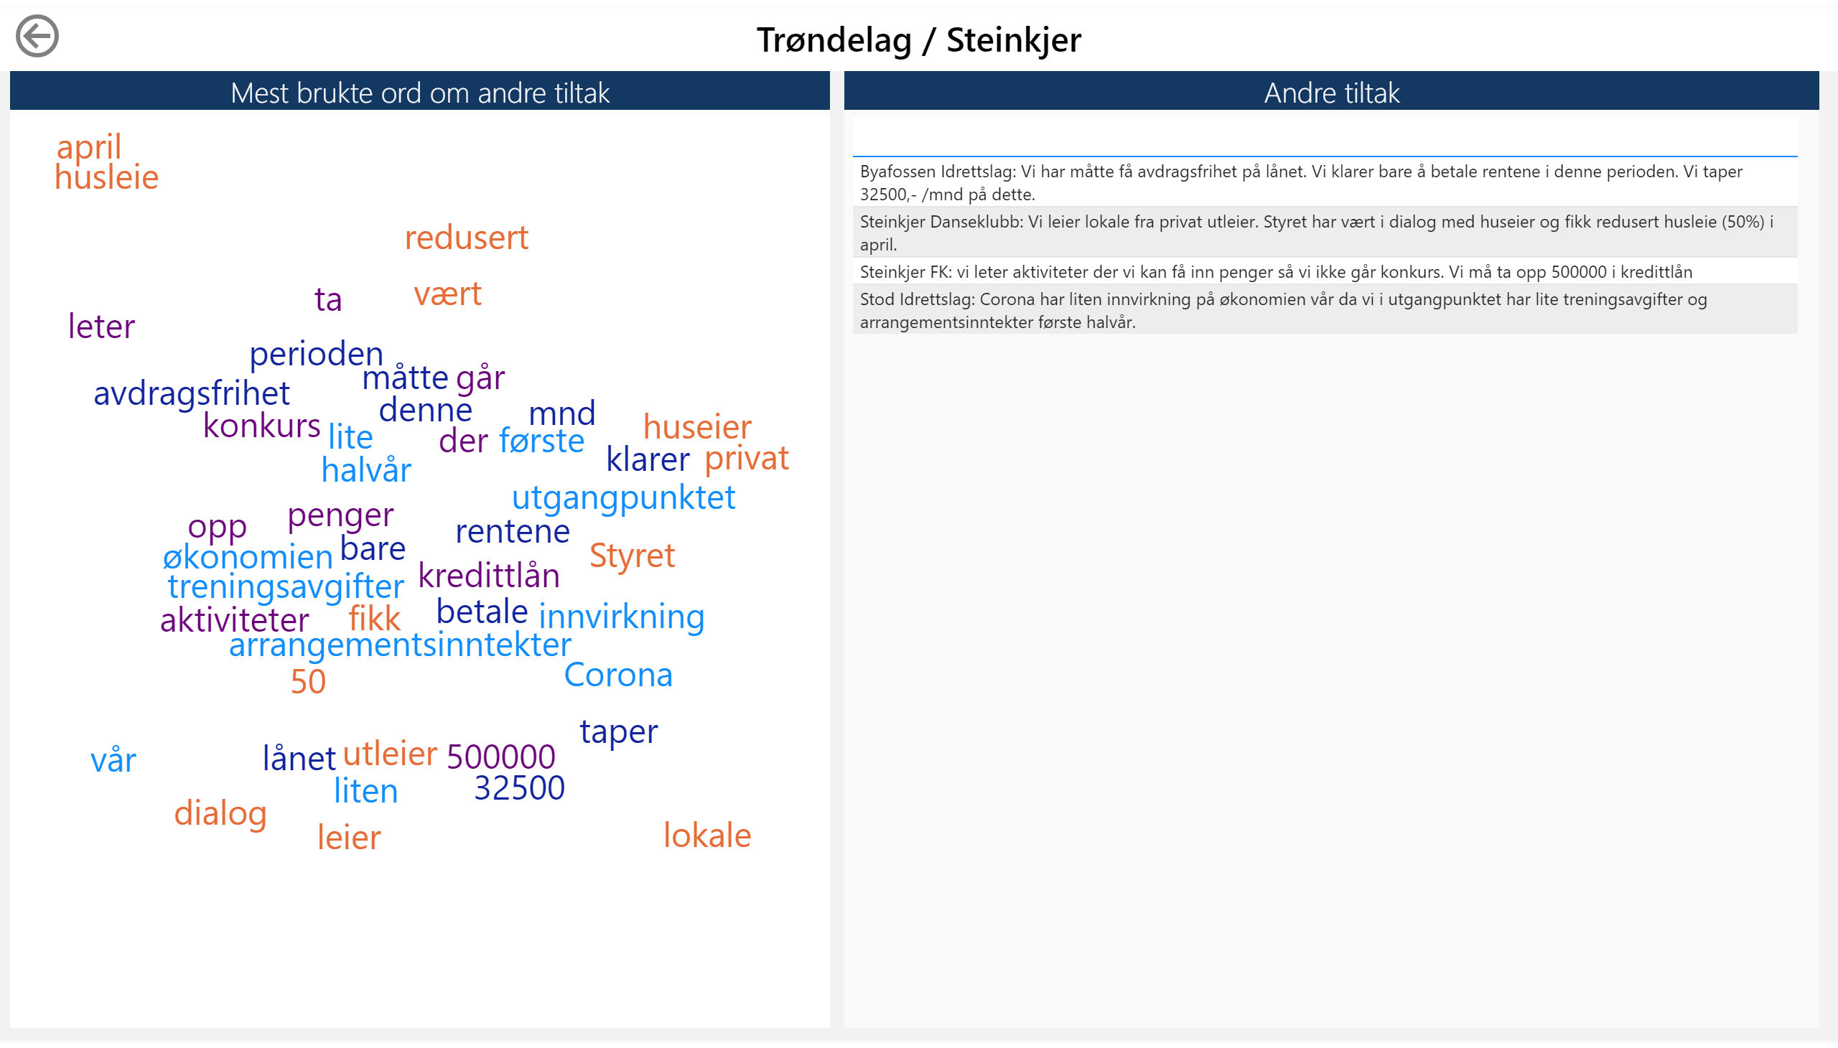

Slide 5
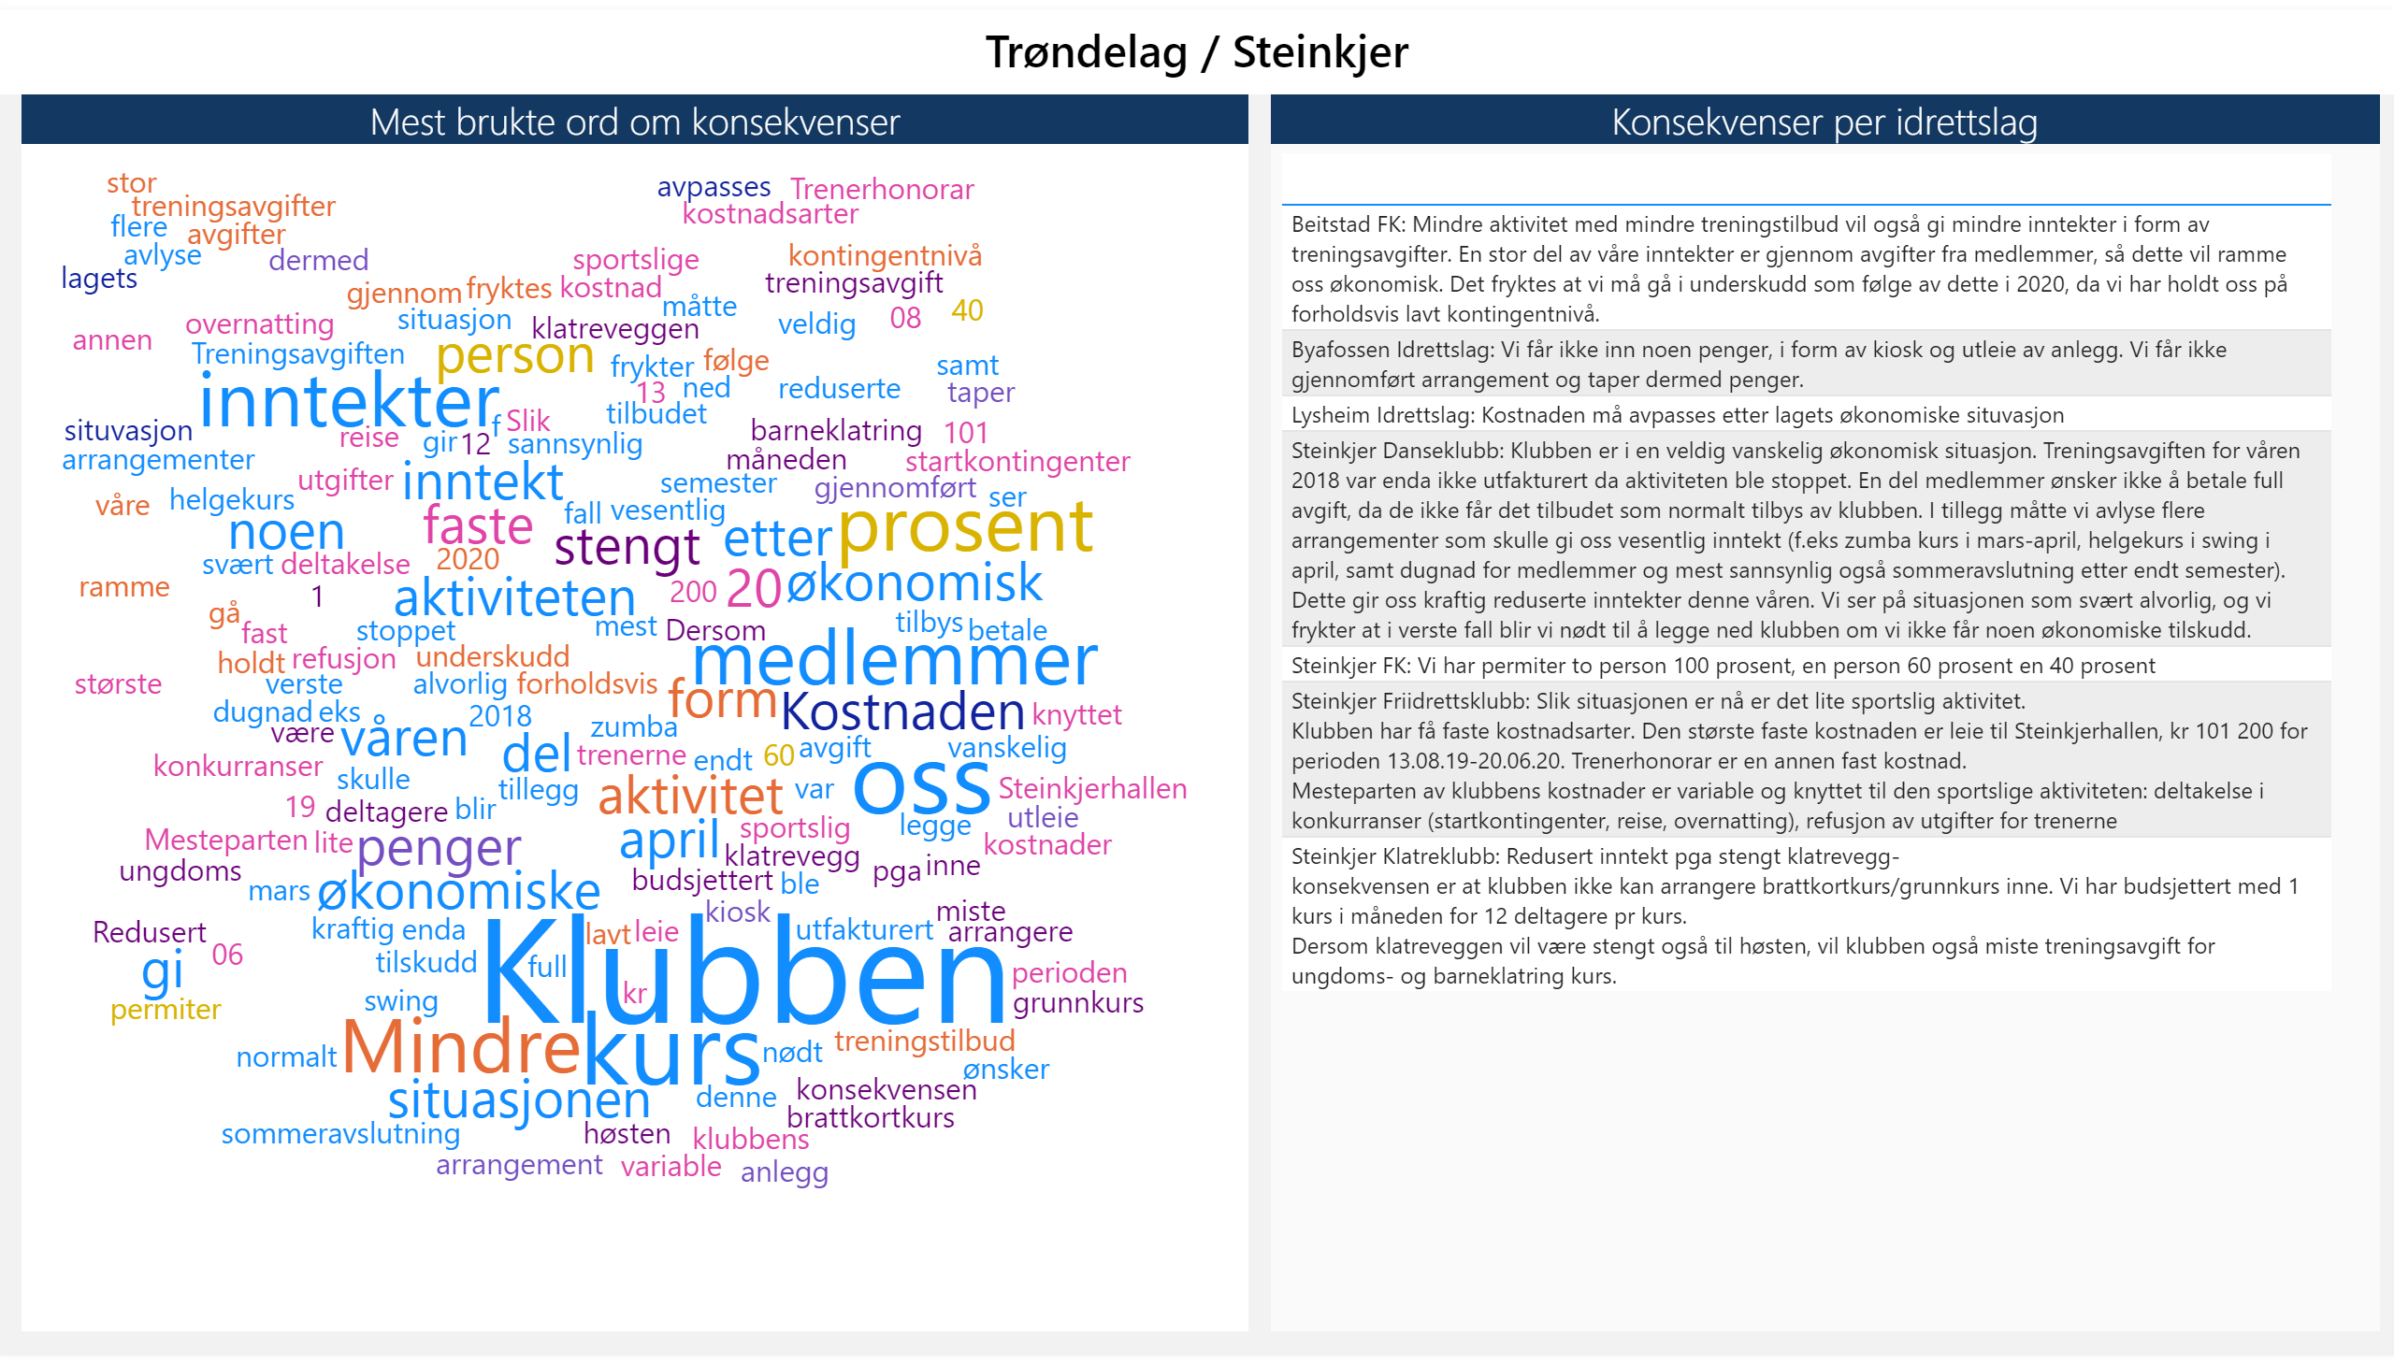

Slide 6
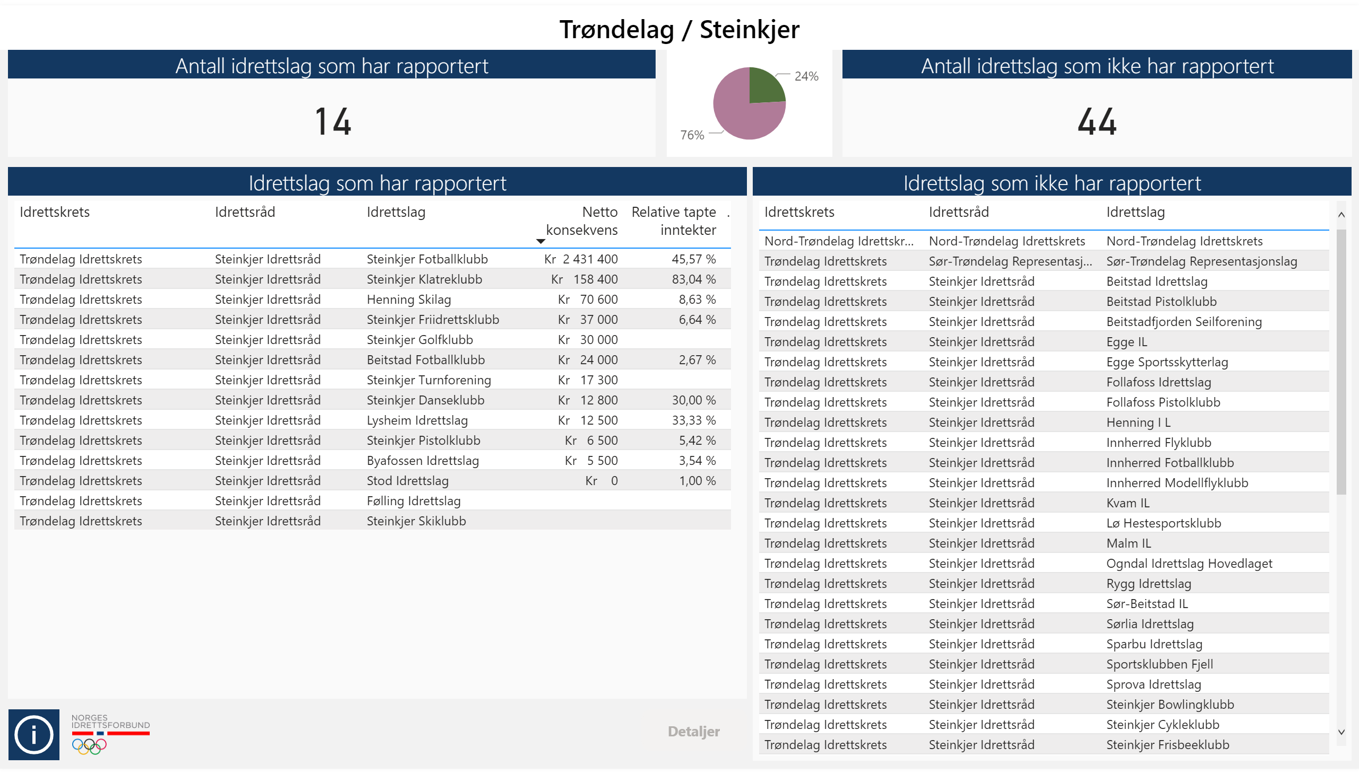

Slide 7
